Slide 1
Pytorch
tips and tricks (pt. 1)

Slide 2
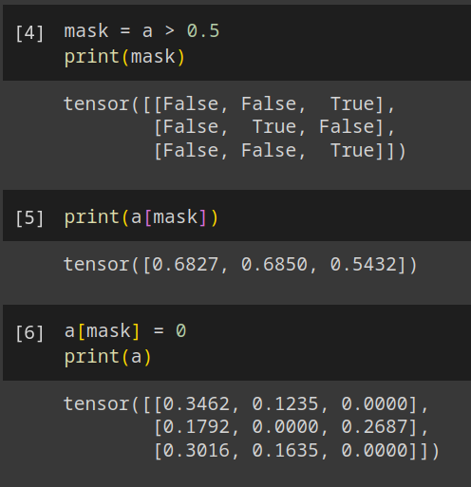
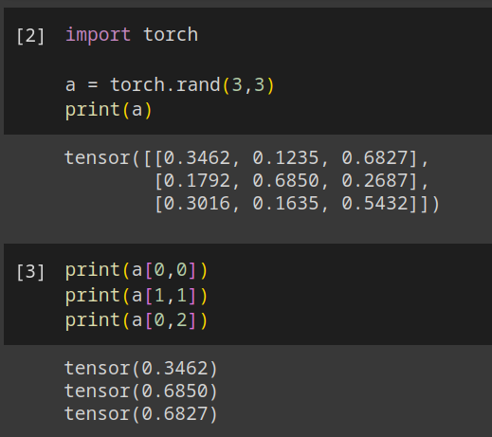
Use boolean masks
In pytorch there are two ways of indexing a tensor:
Using indices
Using masks

Slide 3
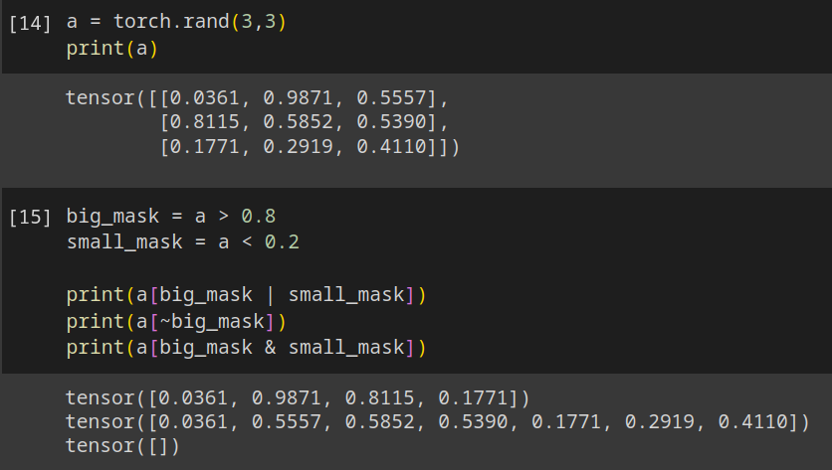
Logic operations on masks
You can perform binary logic operation on masks (and, or, not, ...)

Slide 4
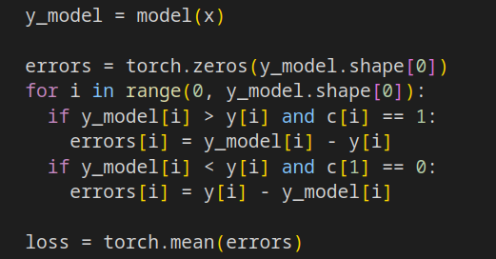
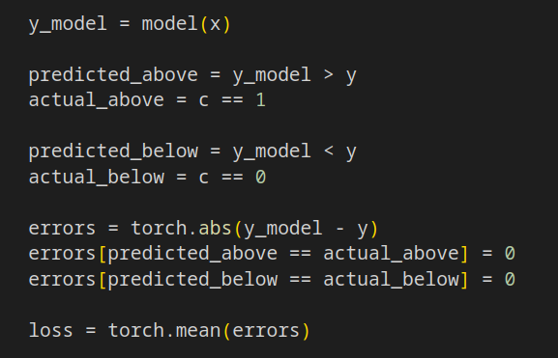

Be aware of the Computational Graph
And this does not?
Why this works?

Slide 5
Subtle differences (working solution)
In pytorch
“set to zero”
is a differentiable
operation
(set gradients to zero)
-
abs
y
set masked
to zero
Model
sum
x
loss
parameters

Slide 6
Subtle differences (error solution)
-
abs
backward
stops here
y
0
e₁
e₂
Model
sum
loss
x
parameters

